Slide 1

Mathematical thinking
A guest lecture by Mr. Chase

Slide 2
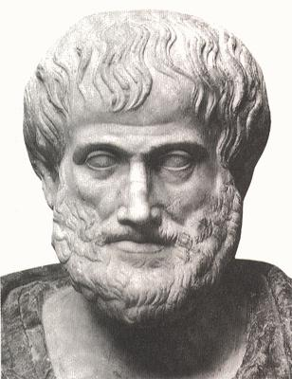
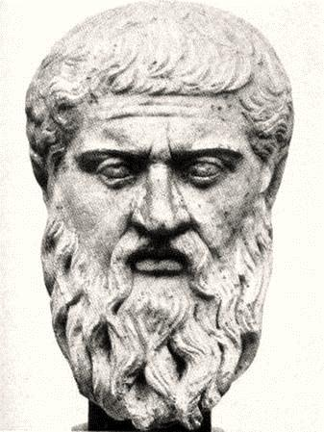
Is mathematics invented or discovered?
Aristotle
Plato

Slide 3
Is mathematics invented or discovered?
Options:
Invented
Discovered
Unresolvable
I don’t know
Poll!

Slide 4
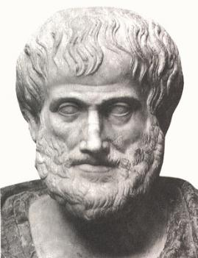




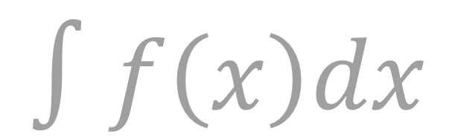
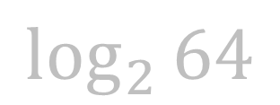

$$∫f\left(x\right)dx$$
$$\sqrt{m}$$
“Newton and Leibniz invented Calculus.”
$$ℝ$$
$$x$$
conventions and symbols
$$\log_{2}{64}$$
invented!
$$f(x)$$
our number system
And if you think mathematics is discovered: if a mathematical theory goes undiscovered, does it truly exist?
$$a+b$$
long division

Slide 5
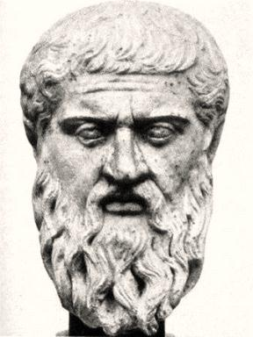




$$ℝ$$
arbitrary notation
Is $2^{67}−1$ prime or composite?
$$x$$
Are there an infinite number of “twin primes”?
$$∫f\left(x\right)dx$$
$$\sqrt{m}$$
discovered!
no contradictions
math is like science—it’s true, regardless of whether we discover it or not.
$$a+b$$
air-tight logic

Slide 6
Correct answer…
discovered!

Slide 7
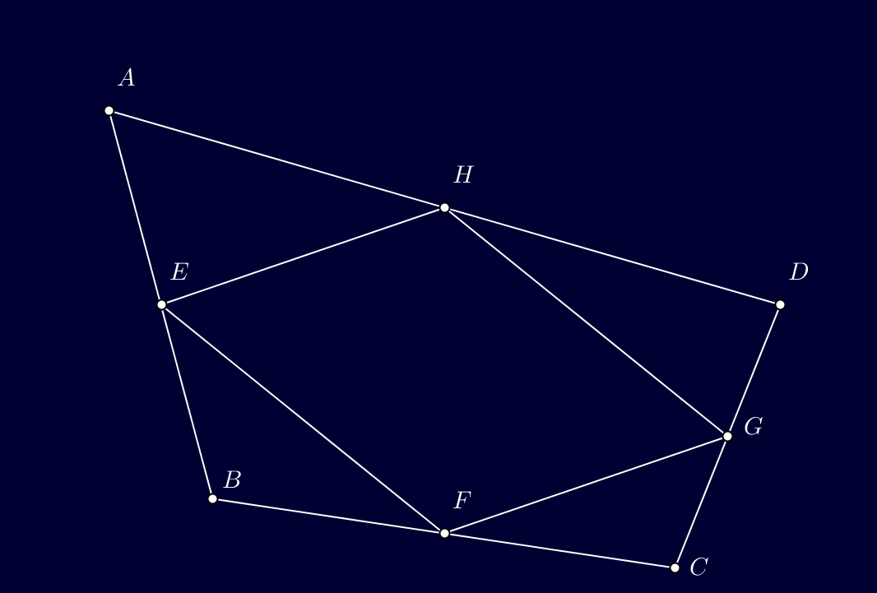
Is this always true? Aren’t you dying for a proof?
Is $9^{n}−1$ always divisible by 8?
There exist two people in DC with the exact same number of hairs on their heads. Why?

Slide 8
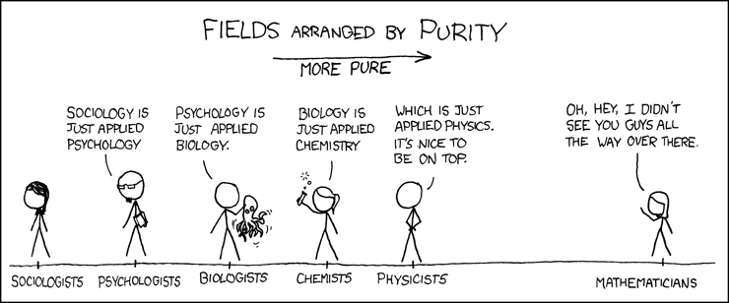
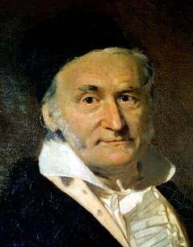
“
”
Mathematics is a queen of science.
Carl Friedrich Gauss

Slide 9
“
what mathematicians have to say…
Wherever there is number, there is beauty.
Proclus
It is impossible to be a mathematician without being a poet in soul.
Sofia Kovalevskaya
”
The mathematician does not study pure mathematics because it is useful; he studies it because he delights in it and he delights in it because it is beautiful.
Jules Henri Poincaré

Slide 10

$$x$$
what mathematics are we free to invent?
the symbols and conventions we choose are arbitrary.
FORMALISM
Mathematics is a game played according to certain simple rules with meaningless marks on paper.
David Hilbert

Slide 11

the field axioms.
Closure of $F$ under addition and multiplication
  For all a, b in F, both $a+b$and $a ·b$are in $F$ (or more formally, $+$ and $−$ are binary operations on $F$).
Associativity of addition and multiplication
  For all $a$, $b$, and $c$ in $F$, the following equalities hold:
  $a+(b+c)=(a+b)+c$ and $a·(b·c)=(a·b)c$.
Commutativity of addition and multiplication
  For all $a$ and $b$ in $F$, the following equalities hold:
  $a+b=b+a$and $a·b=b·a$.
Existence of additive and multiplicative identity elements
  There exists an element of $F$, called the additive identity element and denoted by $0$, such that for all $a$ in $F$, $a+0=a$. Likewise, there is an element, called the multiplicative identity element and denoted by $1$, such that for all $a$ in $F$, $a·1=a$. To exclude the trivial ring, the additive identity and the multiplicative identity are required to be distinct.
Existence of additive inverses and multiplicative inverses
  For every $a$ in $F$, there exists an element $−a$ in $F$, such that $a+(−a)=0$. Similarly, for any $a$ in $F$ other than $0$, there exists an element $a^{−1}$ in $F$, such that $a·a^{−1}=1$. (The elements $a+(−b)$ and $a·b^{−1}$ are also denoted $a−b$and $a/b$, respectively.) In other words, subtraction and division operations exist.
Distributivity of multiplication over addition
  For all $a$, $b$ and $c$ in $F$, the following equality holds: $a·(b+c)=(a·b)+(a·c)$.
See handout for some proofs based on these axioms

Slide 12
group
domain
ring
Can we break or change the rules?
YES.
skew field
Abelian group

Slide 13
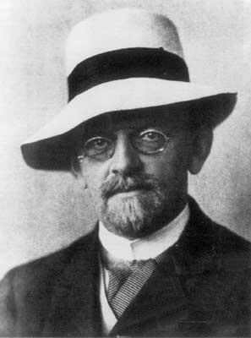
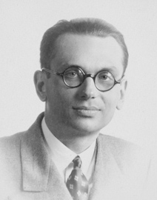
Epic math battles
You can’t prove the thing!
In every formal system, there must be unprovable statements.
Prove the thing!
I want to create a formal system in which we can prove all statements.
David Hilbert
Kurt Gödel

Slide 14
Silly example
Axioms: it is raining outside.
if it is raining, I will take an umbrella.
Statements: I will take an umbrella.
It is not raining outside.
I will take my pet hamster as well.
Provably true.
Provably false.
Undecidable

Slide 15
Math is useful
It’s like a gorgeous painting that also functions as a dishwasher!
Ben Orlin
But…WHY is it useful?

Slide 16
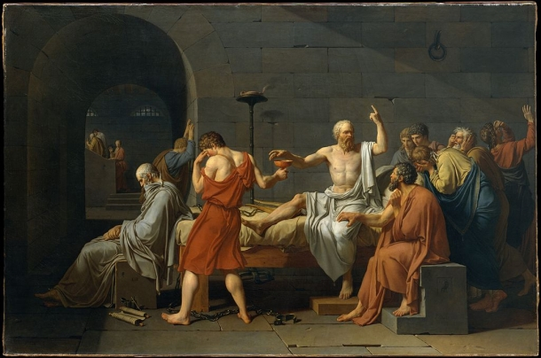
Why study math?
Liberal Education
Glimpsing the mind of God

Slide 17
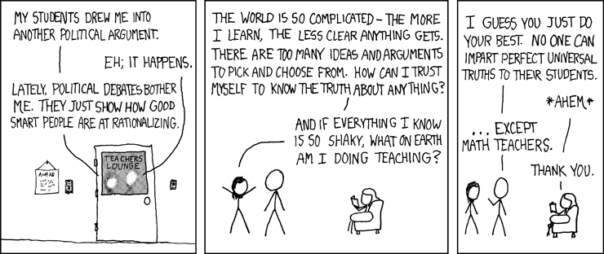
In summary…
Math is different. It allows certain knowledge.

Slide 18
Questions?

